Slide 1

LLM + Evolutionary Search for Automatic Algorithm Design (EC: From Binary Vectors to Thoughts)
Qingfu Zhang
Department of Computer Science,
City University of Hong Kong
Hong Kong
qingfu.zhang@cityu.edu.hk

Slide 2
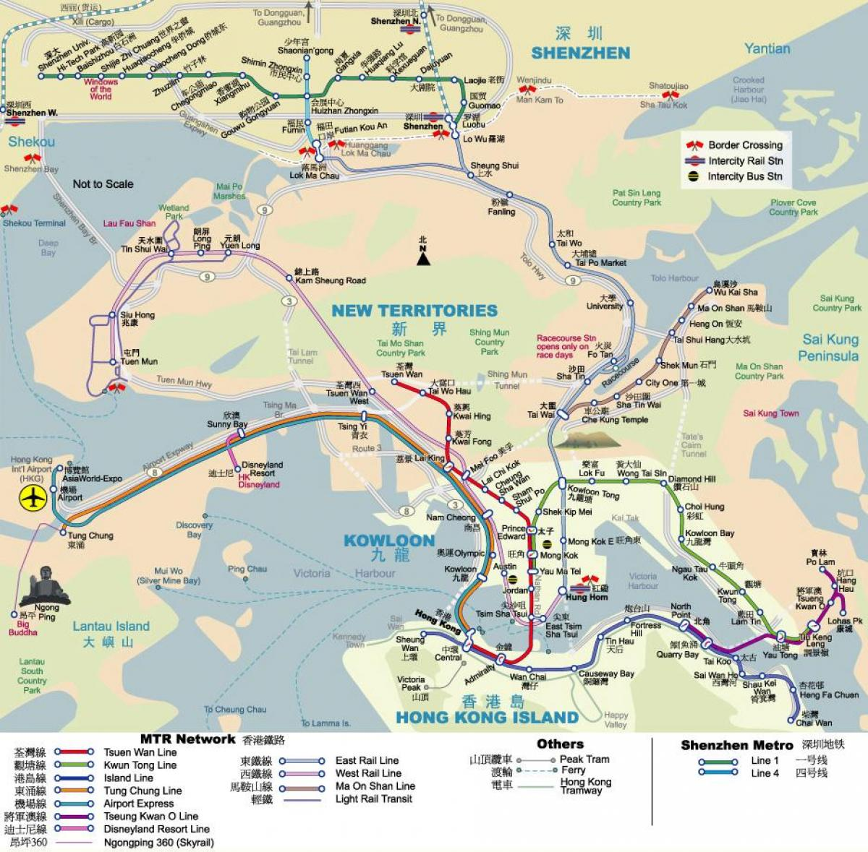
CityU of HK

Slide 3
My office

Slide 4

Optimization and Learning Group
Sponsored by RGC, GRF, ITF, ANR, NFSC, MOT, Huawei, CityU,…
Research Areas: Metahursitics, Optimization, Machine learning, Multiobjective Opt. Interface btw AI and Heuristics.

Slide 5
无处不在的优化计算需求
行业 | 典型问题 | 优化计算任务
制造业 | 库存管理，供应链管理，生产排程，流水线设计，维护计划，产量预测，工业机器人动作设计，AVG | 切割、下料问题，生产排程，车间流水线优化
石油化工 | 资源计划，收益管理，原油精炼工艺优化，原料配比优化，管网设计，人员排班，配送方案 | 配比问题（blending and mixing),VRP,网络设计
能源 | 发电机组优化，资源调度，运作管理，智能电网，定价，电网设计，能源、碳配额交易 | 发电机组优化，网络设计，网络流，设施选址，二次指派
金融 | 资产组合优化，对冲策略，风险管理，税务筹划，反欺诈，用户评级，资产定价 | 资产组合优化，二次规划，锥优化
半导体 | 生产计划，芯片布局优化，工艺优化，生产排程 | 生产排程，车间流水线优化
航空、机场 | 机组人员排班，航班计划，飞机维护计划，机场运作管理 | 网络设计，多产品网络流，设施选址，装箱问题，护士排班问题
汽车企业 | 零部件管理，原型设计，库存优化，生产运作管理，工程选址，配送优化 | 设施选址，二次指派，生产排程
广告与市场营销 | 搜索引擎排序优化，自动广告拍卖机制，客户行为分析，产品营销，库存管理，市场战略规划 | 组合拍卖，线性回归，背包问题，集合覆盖问题
航天&国防 | 机器利用率优化，设备维护计划，成本控制，生产计划，供应保障 | VRP，TSP，网络流，生产排程
医疗行业 | 人员排班，院内排队系统，预约计划，人力、设备调度，器官捐赠匹配，库存管理 | 护士排班问题，匹配问题
零售业 | 商铺选址，布局设计，商品摆放，库存管理，定价优化，供应链管理，人员排班，商铺配送 | 设施选址，二次指派，VRP，护士排班问题
政府/公共部门 | 频段拍卖，交通优化，城市规划，经济计划，预算管理 | 组合拍卖，网络流，设施选址，二次指派
芯片设计 | 微架构搜索、逻辑综合、布局布线、测试验证、掩码计算 | 参数优化、图优化、摆放/走线组合优化、形式化优化
… | … | …

Slide 6
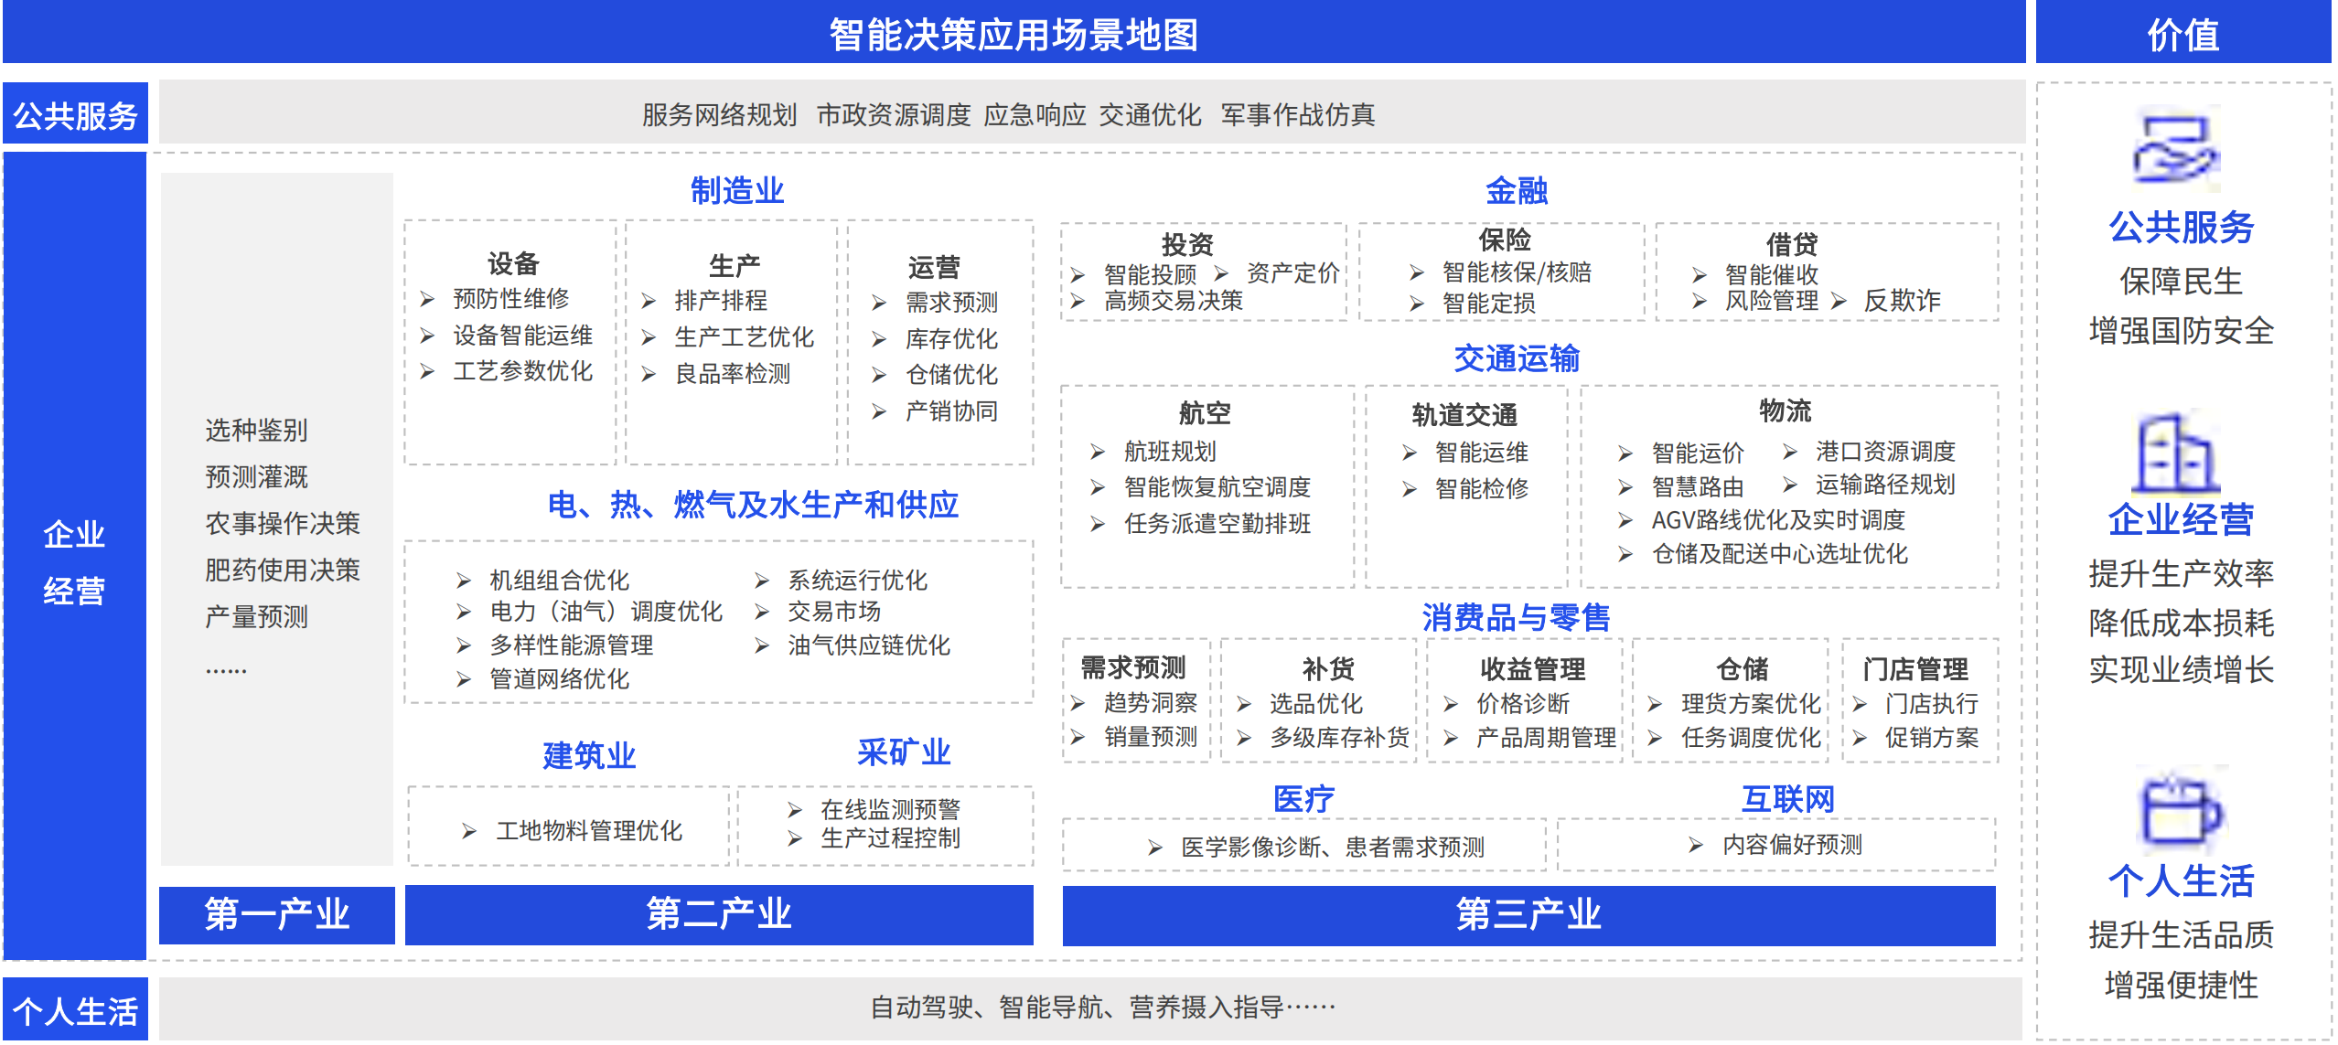
优化计算是智能决策的核心底座技术，市场空间巨大
智能决策可以为企业带来新的运营⽅式，在决策机制上降低对人的依赖，从而显著提高企业的收益增长速度，提升企业成长空间。
管理层最关心的大数据应用场景多数都可以使用智能决策技术进行赋能，未来通过智能决策机制可以在供应链及制造管理方面释放的价值空间高达1.2-2万亿美元。
企业/工业软件优化问题基本求解流程：密集的专业人力投入需求

Slide 7
Outline
Evolutionary Algorithms
Impossible Triangle in Alg Design
Automatic Algorithm Design
Evolution of Heuristics
Conclusions

Slide 8
Evolutionary Computation
Developed in 1940s (?), 1960s. Popular after 1990s.
Early Names: A. Turing, J. Holland, K. DeJong,
D. Goldberg, I. Rechenberg, HP Schwefel. ……
Optimization algorithms inspired by biological evolution
Evolutionary Algorithms is not an optimizer”-Holland
Some modern EAs are not nature-inspired.
Population-based ”trial and error” problem solvers
Some EAs are not population-based (e.g. Estimation of Distribution Alg).
A subarea of Computational Intelligence (CI)
A subarea of optimization and heuristics!

Slide 9
Evolutionary Algorithm (EA) =Population Based Iterative Search Method
Population: a set of candidate solutions.
Selection: select fittest solutions to be parents for next generation.
Crossover: mix two (three or many) parent solutions to produce new solutions.
Mutation: modify a parent solution to produce a new solution.
One iteration in a simple EA
Population at generation t
Parent Set
Population at generation t+1
Crossover
Mutation
……
Selection

Slide 10
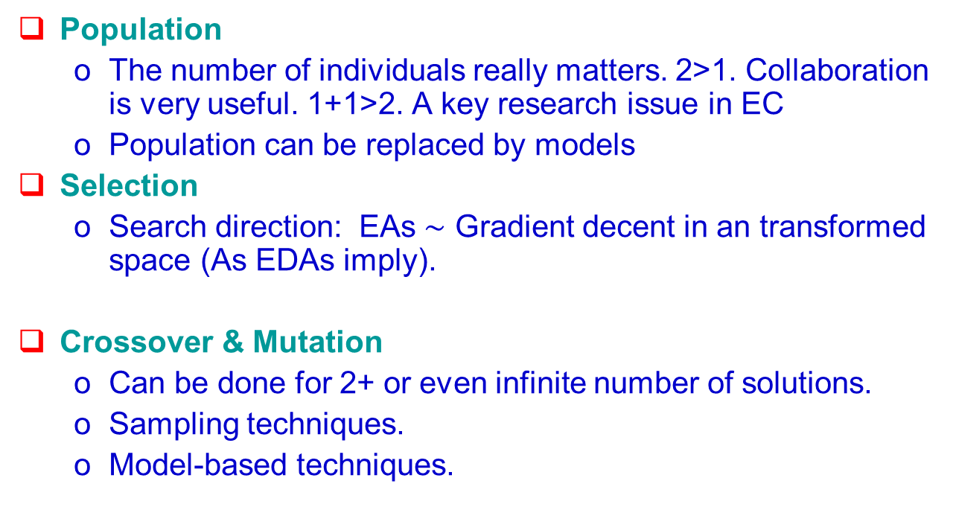
Population
The number of individuals really matters. 2>1. Collaboration is very useful. 1+1>2. A key research issue in EC
Population can be replaced by models
Selection
Search direction: EAs $\sim$ Gradient decent in an transformed space (As EDAs imply).
Crossover & Mutation
Can be done for 2+ or even infinite number of solutions.
Sampling techniques.
Model-based techniques.
Notes:
Now let’s see what we can learn natural evolution. In fact, I should say, What have the GA people learned from the natural evolution?
The first thing that is population.
The number of individuals at each generation really matters.
Why are pandas endangered? One reason is that the number of pandas are very small.
The second important thing in natural evolution is selection.
We have so-called the “Survival of the fittest”.
That means, the better an individual is, the more possible it will become a parent for the next generation.
The third thing is crossover.
At the level of chromosome, an offspring (I.e, child) takes one part from its mother and the other part from its father.
Crossover is a major mechanism for generating new individuals.
Another very important thing in natural evolution is mutation
Sometimes, some part of chromosome will be randomly changed. So, In the real-world, sometimes, you can see that some children do not look like their parents.
These are the basic things that Gas people know about the natural evolution. Population, selection, crossover and mutation make our human being become better and better generation by generation.

Slide 11
Solution Representation in EC
During 70’s-early 90’s , most GA people used a binary string to represent a solution
Theoretical Reasons: Scheme theory, Building block assumption.
Real vector
Permutation vector
Computer Program (GP): search for a good program
Any data structure.
0
0
1
0
1
0
1
1

Slide 12
Evolutionary Alg vs Traditional Opt Alg
Traditional math program methods
Efficient, with theoretical guarantee.
Domain knowledge, good math properties.
A solution must be represented as a well-understood math object (modelling).
Evolutionary algorithms (most heuristics)
Not very efficient. Often without theoretical guarantee
Easy to implement. Suitable when little problem-specific knowledge is available.
In principle, solution can be represented in any data structure.
It is a big challenge to do optimization when solutions are “thoughts” or “ideas”.

Slide 13
Outline
Evolutionary Algorithms
Impossible Triangle in Alg Design
Automatic Algorithm Design
Evolution of Heuristics
Conclusions

Slide 14

Impossible triangle for NP-complete problems
Any Instance
Optimal
Fast=Polynomial Time
Unless NP=P

Slide 15
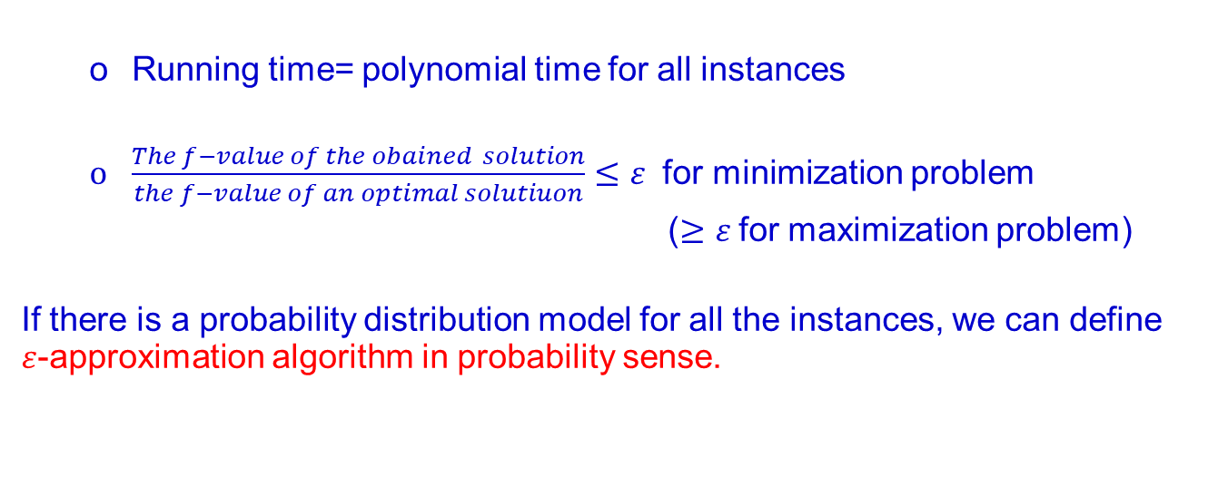

$ε$-approximation algorithm
Running time= polynomial time for all instances
$\frac{The f−value of the obained solution}{the f−value of an optimal solutiuon}≤ε$ for minimization problem
($≥ε$for maximization problem)
If there is a probability distribution model for all the instances, we can define $ε$-approximation algorithm in probability sense.

Slide 16
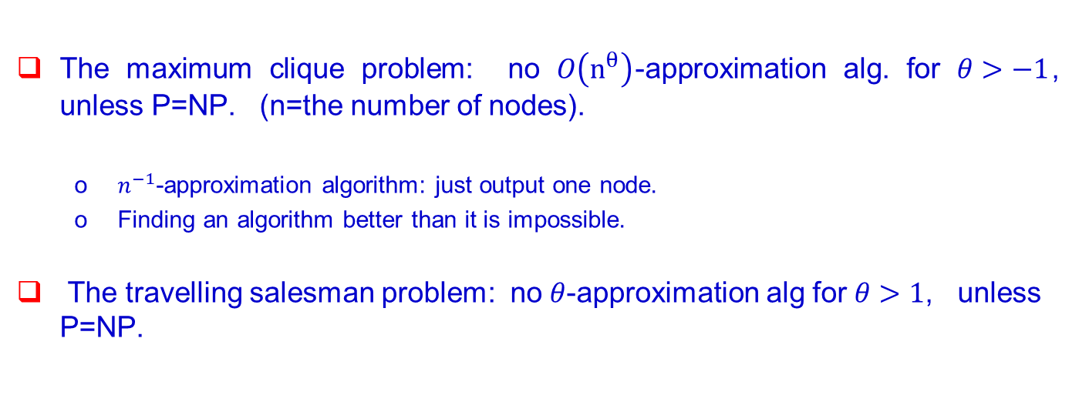
甘蔗没有两条甜 for any instances
The maximum clique problem: no $O\left(n^{θ}\right)$-approximation alg. for $θ>−1$, unless P=NP. (n=the number of nodes).
$n^{−1}$-approximation algorithm: just output one node.
Finding an algorithm better than it is impossible.
The travelling salesman problem: no $θ$-approximation alg for $θ>1$, unless P=NP.

Slide 17
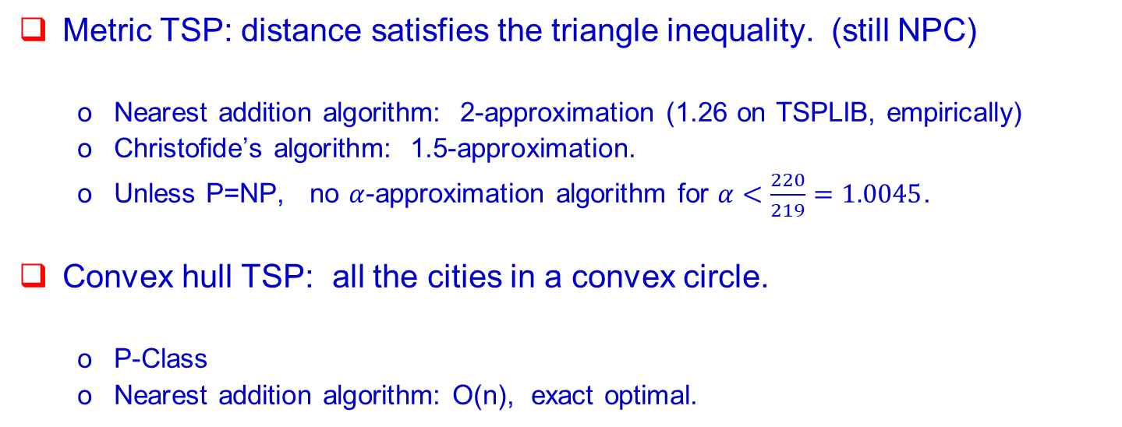
Some instance subsets may be much easier
Metric TSP: distance satisfies the triangle inequality. (still NPC)
Nearest addition algorithm: 2-approximation (1.26 on TSPLIB, empirically)
Christofide’s algorithm: 1.5-approximation.
Unless P=NP, no $α$-approximation algorithm for $α<\frac{220}{219}=1.0045$.
Convex hull TSP: all the cities in a convex circle.
P-Class
Nearest addition algorithm: O(n), exact optimal.

Slide 18
Outline
Evolutionary Algorithms
Impossible Triangle in Alg Design
Automatic Algorithm Design
Evolution of Heuristics
Conclusions

Slide 19
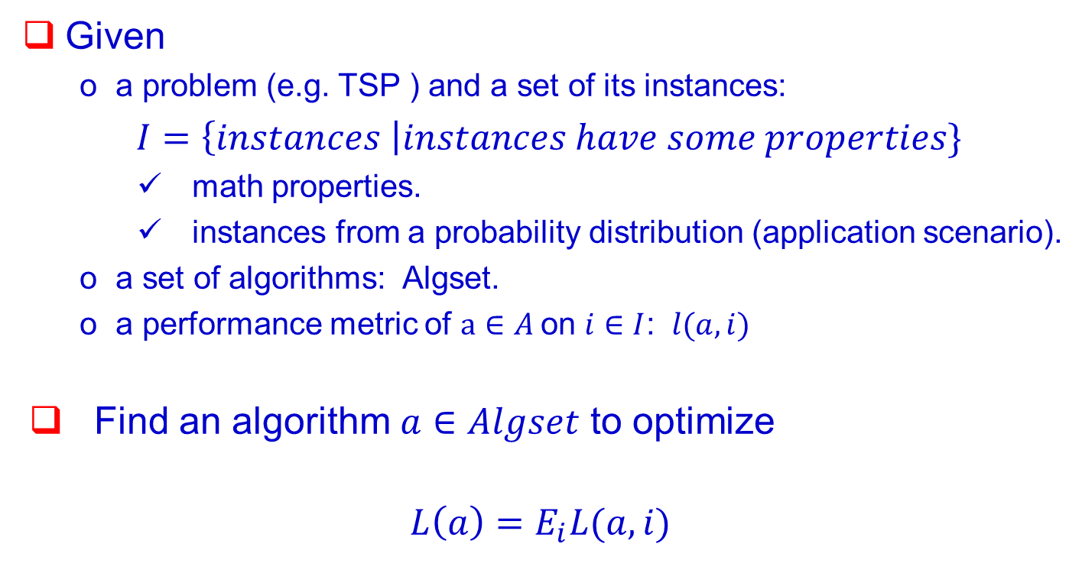
Algorithm Design
Given
a problem (e.g. TSP ) and a set of its instances:
$I=\left\{instances \right|instances have some properties\}$
math properties.
instances from a probability distribution (application scenario).
a set of algorithms: Algset.
a performance metric of $a∈A$on $i∈I$: $l(a,i)$
Find an algorithm $a∈Algset$ to optimize
$${L\left(a\right)=E}_{i}L(a,i)$$

Slide 20
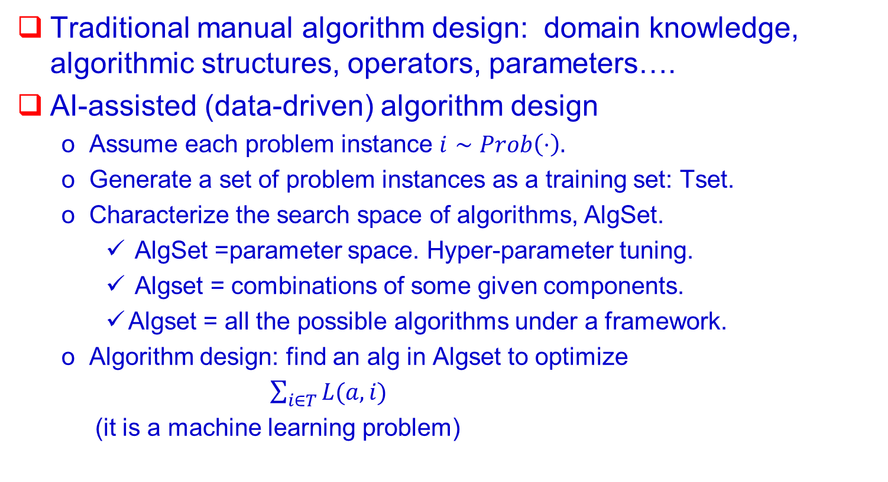
Traditional Design vs AI-assisted Design
Traditional manual algorithm design: domain knowledge, algorithmic structures, operators, parameters….
AI-assisted (data-driven) algorithm design
Assume each problem instance $i∼Prob\left(⋅\right).$
Generate a set of problem instances as a training set: Tset.
Characterize the search space of algorithms, AlgSet.
AlgSet =parameter space. Hyper-parameter tuning.
Algset = combinations of some given components.
Algset = all the possible algorithms under a framework.
Algorithm design: find an alg in Algset to optimize
$\sum_{i∈T}{L(a, i)}$
(it is a machine learning problem)

Slide 21
Outline
Evolutionary Algorithms
Impossible Triangle in Alg Design
Automatic Algorithm Design
Evolution of Heuristics
Conclusions

Slide 22
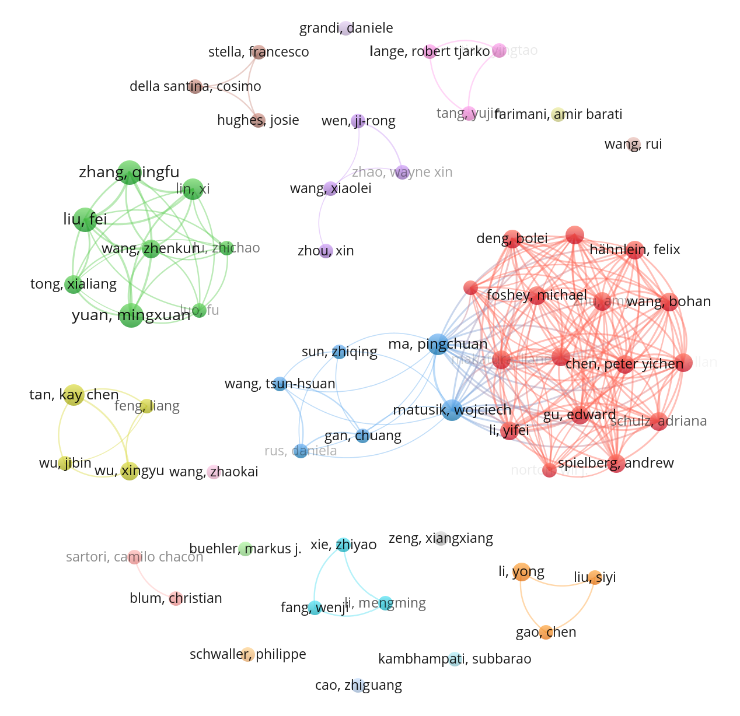
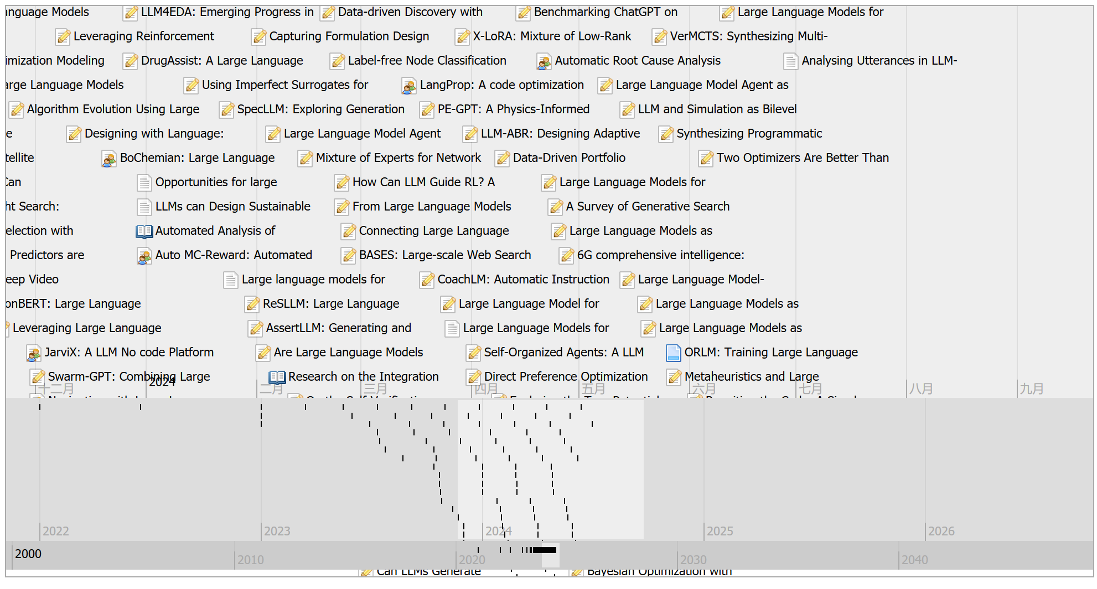
学术界，乘着ChatGPT的东风，基于大模型的自动算法设计快速发展，展现出了传统方法无可比拟的通用化、智能化优势
从2023年初开始，基于大模型的算法优化相关工作急剧增加，在Google Scholar上统计了LLM for algorithm design相关工作，过滤得到160+ papers，具体论文发布时间和相关研究团队统计如下：
Sakana: Devid Ha, Chris Lu
Google TU Berlin
Huawei CityU Optimization
Heuristic design
Fudan
GIT
MIT GIT Harvard
Machine learning
Manufacturing
Industry
MIT
PolyU CQU SZU
Optimization
Heuristic design
Harvard
Hunan
Tsinghua
Social science
Network
IIIA-CSIC
Gabriela Ochoa
SMU
论文发布时间统计
主要研究团队统计

Slide 23
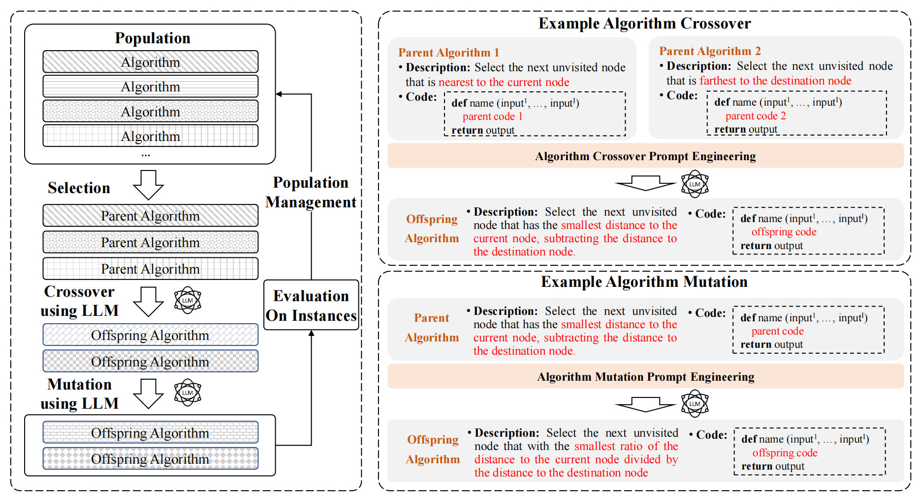
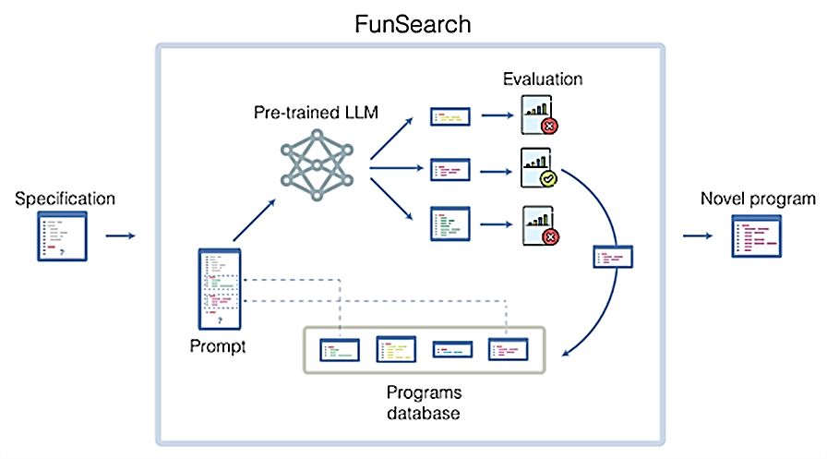
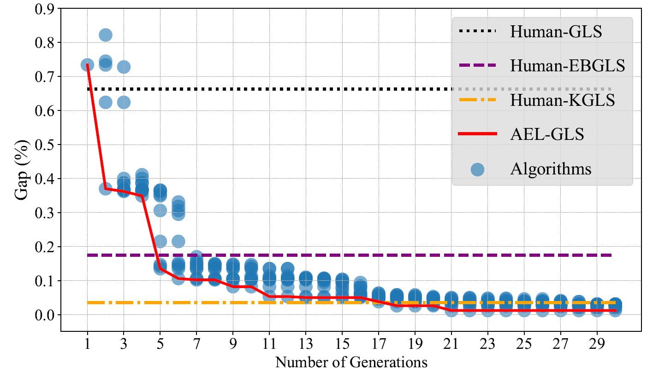
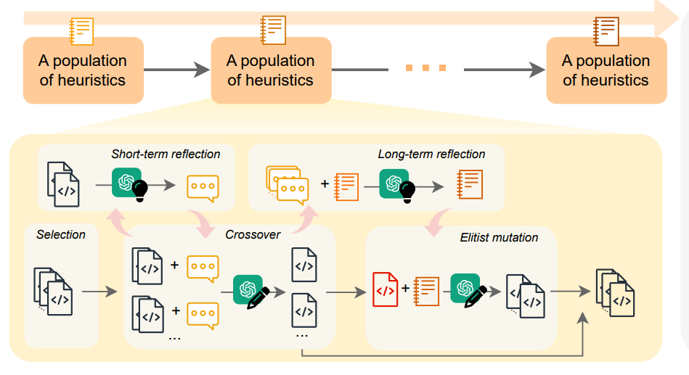
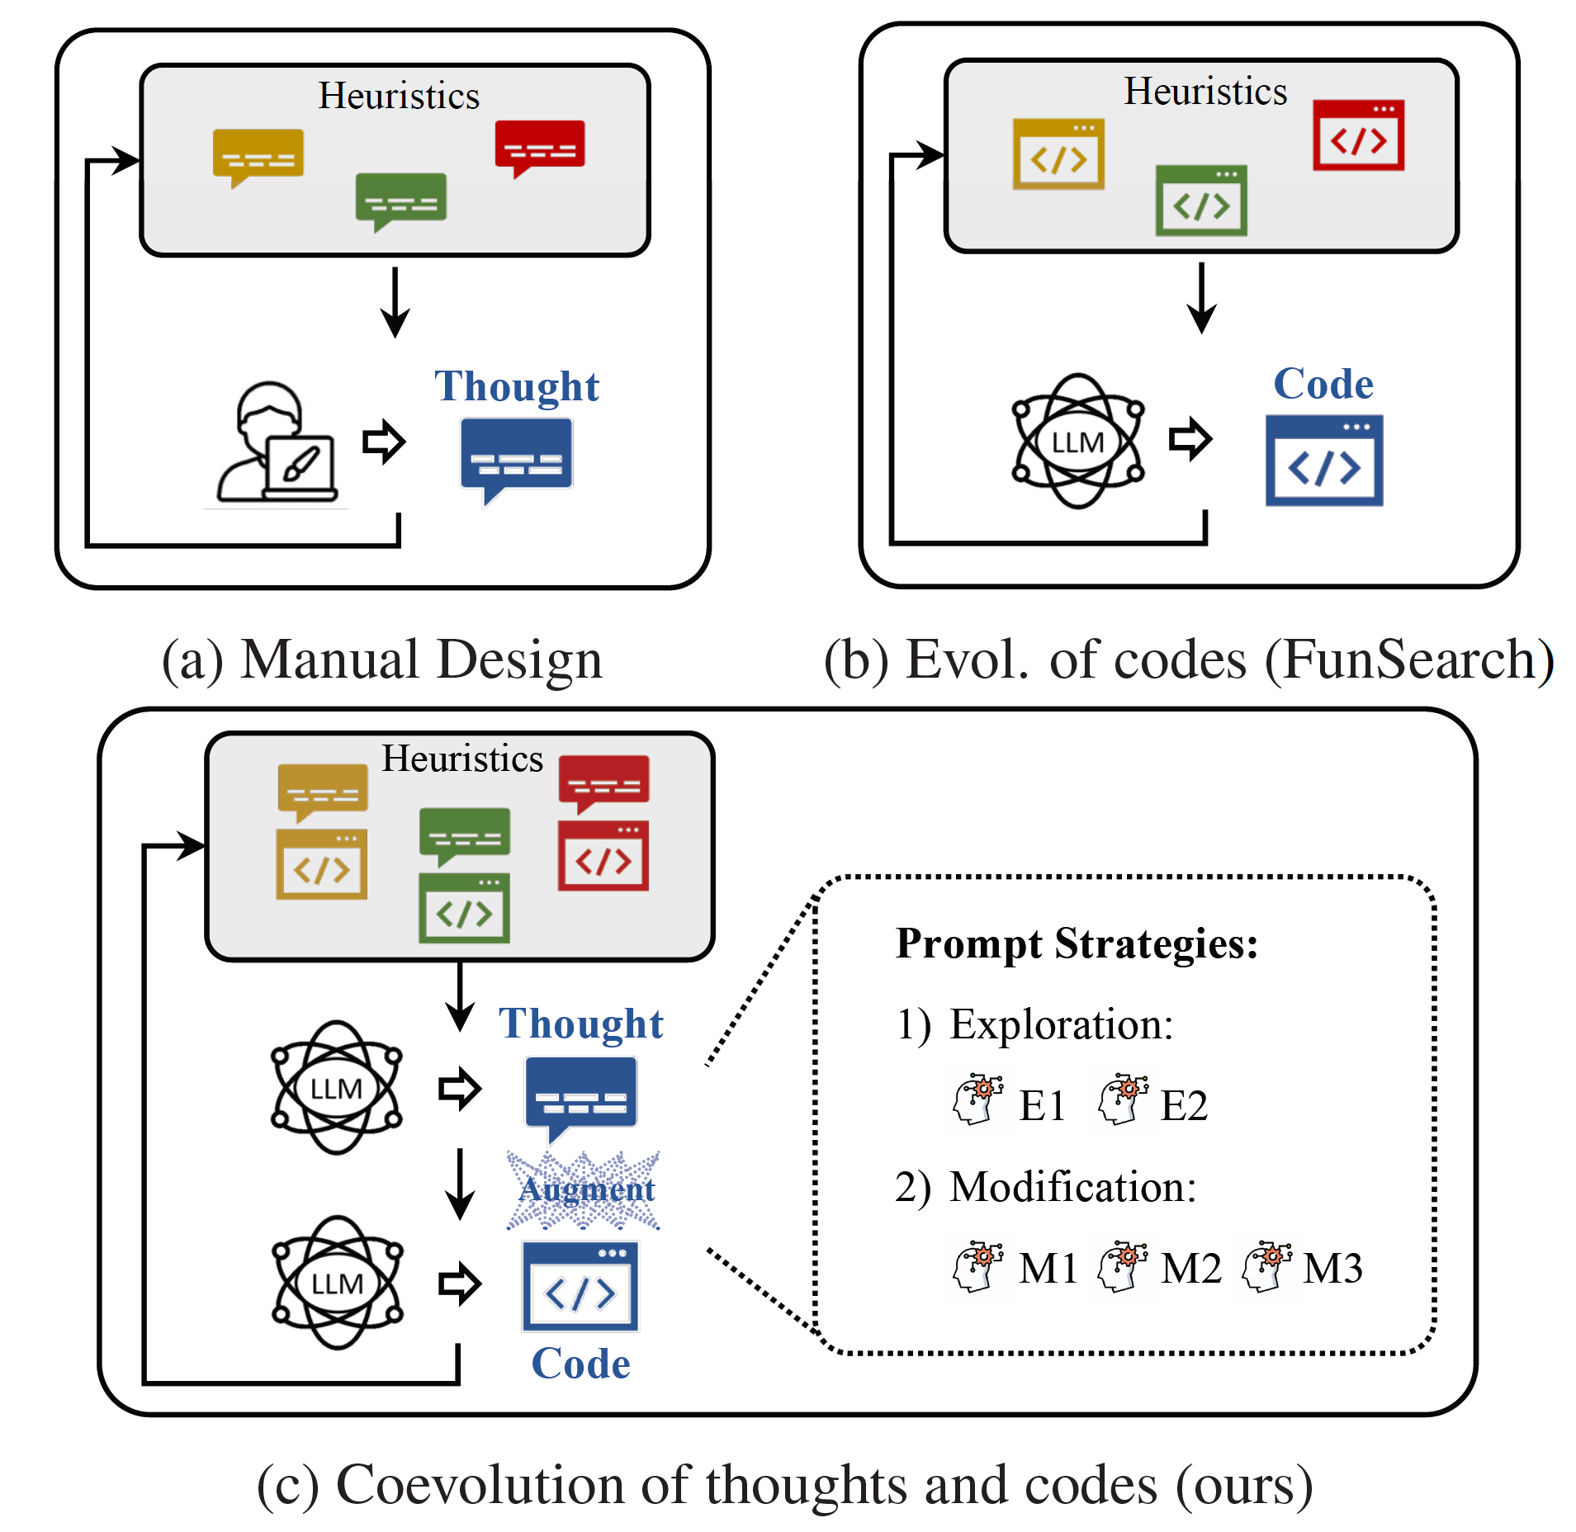
基于大模型的自动算法设计: Evolutionary Search + LLM
Others
Ours
2023-11-26 Algorithm Evolution
using Large Language Model
2023-12-14（Nature） Google FunSearch 基于LLM的自动算法设计
2024-01-04 Beating Human:
Design of Efficient Guided Local Search
2024-02-02 ReEVO, LLM for Combinatorial Optimization (Peking, SMU)
2024-05 Evolution of Heuristics … Using Large Language Model. (ICML 2024 Oral)

Slide 24
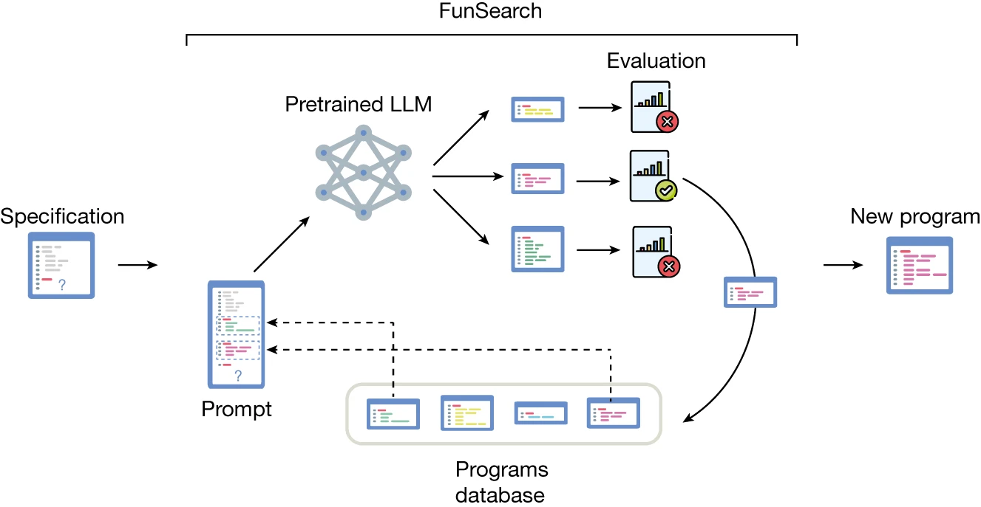
代表性工作，Google Funsearch^{[1]} & Our EOH(Evolution of Heuristic^{[2]})
Google Funsearch，隐式进化，大力出奇迹
Our EOH，显式进化，资源更高效
通过LLM直接生成问题对应的算法代码，而非直接生成问题的解，并通过算法进化的思想隐式迭代生成高效的算法。
输出可解释的算法，而非解
使用中小规模的LLM(15.5B)进行算法生成
预先给了一个骨架算法框架
维护了候选算法池/种群，种群数1百万
通过样本集合进行快速的算法评估
通过算法进化思想（隐式），迭代提升算法质量
通过LLM生成问题对应的算法设计思想和算法代码实现，并通过算法进化算子显式迭代生成高效的算法。
输出可解释的算法，而非解
使用chatGPT或者开源LLM(13B)进行算法生成
预先给了一个骨架算法框架
维护了候选算法池/种群，种群数几十
通过样本集合进行快速的算法评估
设计算法进化算子显式进化
提前识别算法核心部分，并通过降低算法复杂度实现泛化增强
[1] Romera-Paredes B, Barekatain M, Novikov A, et al. Mathematical discoveries from program search with large language models[J]. Nature, 2024, 625(7995): 468-475.
[2] Liu F, Tong X, Yuan M, et al. Evolution of Heuristics: Towards Efficient Automatic Algorithm Design Using Large Language Model. ICML Oral (2024).

Slide 25




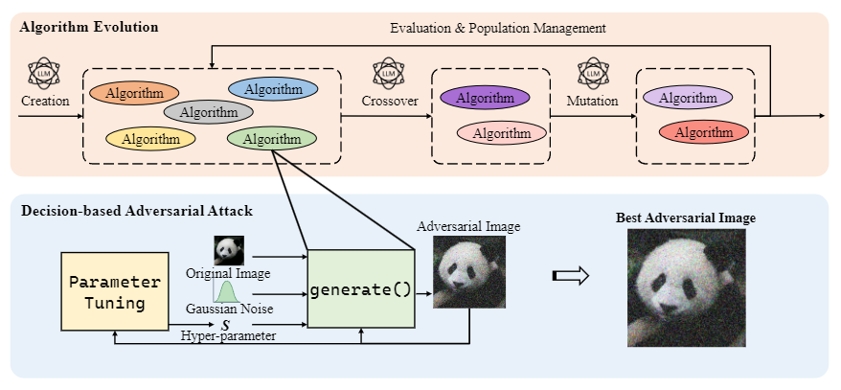
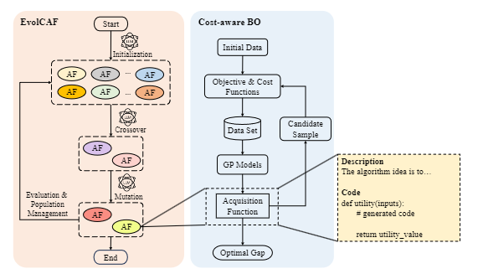
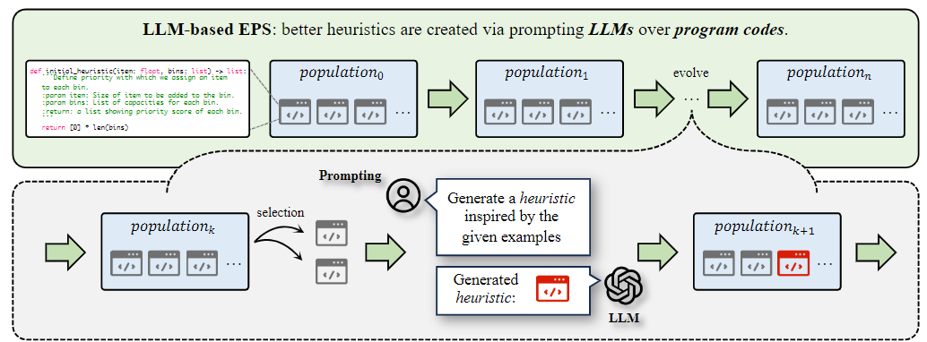












Image Attack, 2024
Bayesian Opt.
Benchmark study
PPSN 2024
GECCO 2024 Humies Competition

Slide 26


EoH Framework
Initialization
Initialization Prompting
Parsing
Population
Management
Heuristic
Heuristic
Heuristic
Heuristic
Heuristic
Heuristic
Heuristic
Selection
Evaluation
Crossover
Heuristic
Crossover
Prompting
Parsing
Heuristic
Heuristic
Heuristic
Mutation
Mutation
Prompting
Parsing
Heuristic
Heuristic

Slide 27
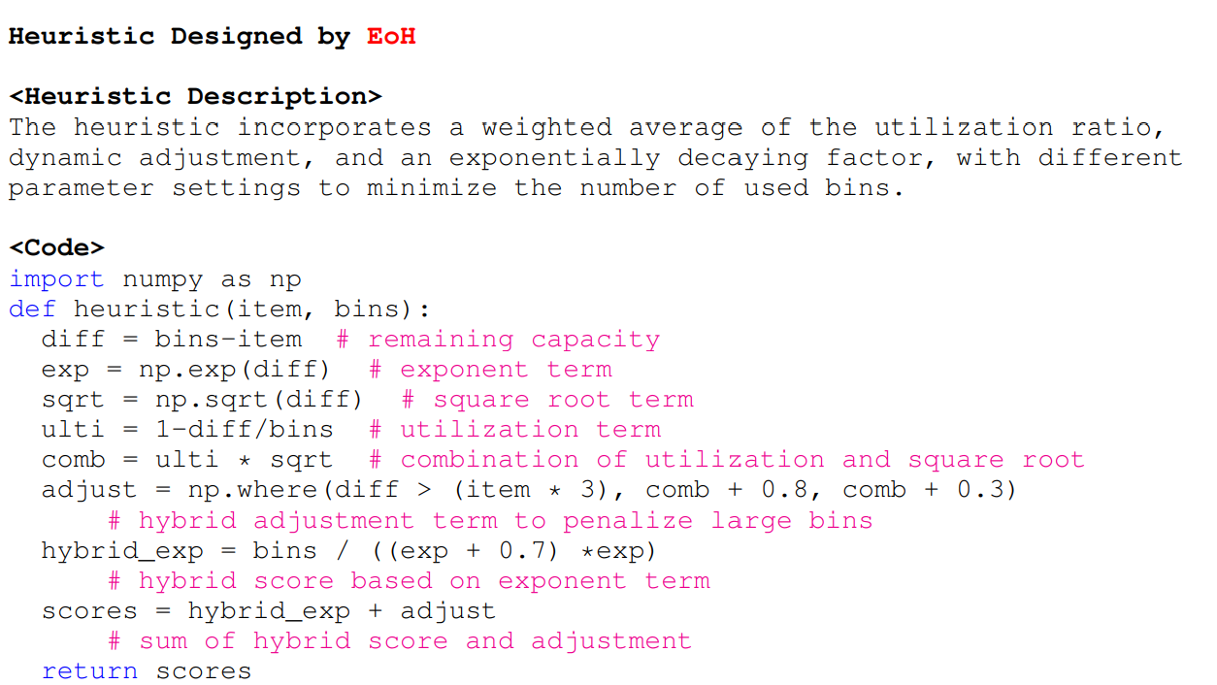
Individual Representation in EoH
A heuristic description (Thought)
In natural language
A code block (Code)
Python code snippet with a predefined function name, specific inputs, and expected outputs
A fitness value
Assessment based on performance across various instances.
An example on online bin packing problem

Slide 28
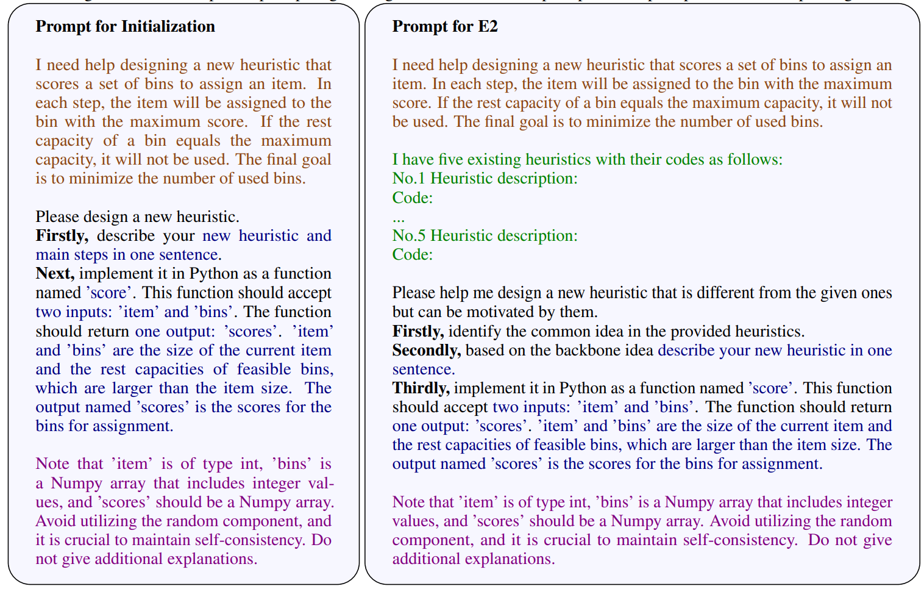
Generate New Heuristic by Prompting LLM
LLM Prompt strategies:
Initialization (I1)
Genetic operator (E1, E2, M1, M2, S1)
Prompt consists of five components:
A description of the task
Parent heuristic(s)
Operator-specific prompts
Expected outputs
Notes

Slide 29
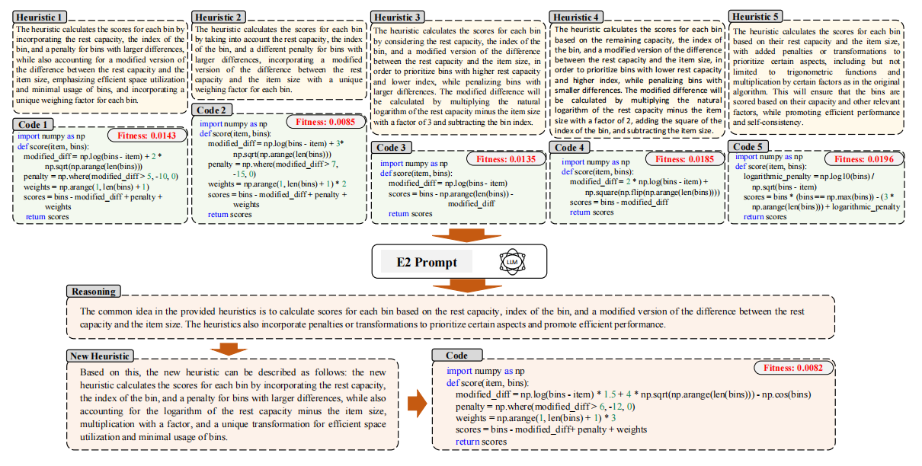
Illustration of Heuristic Generation in EoH on Online BP
Fei Liu, Xialiang Tong, Mingxuan Yuan, Xi Lin, Fu Luo, Zhenkun Wang, Zhichao Lu, and Qingfu Zhang, “Evolution of Heuristics: Towards Efficient Automatic Algorithm Design Using Large Language Model”, ICML (2024).

Slide 30
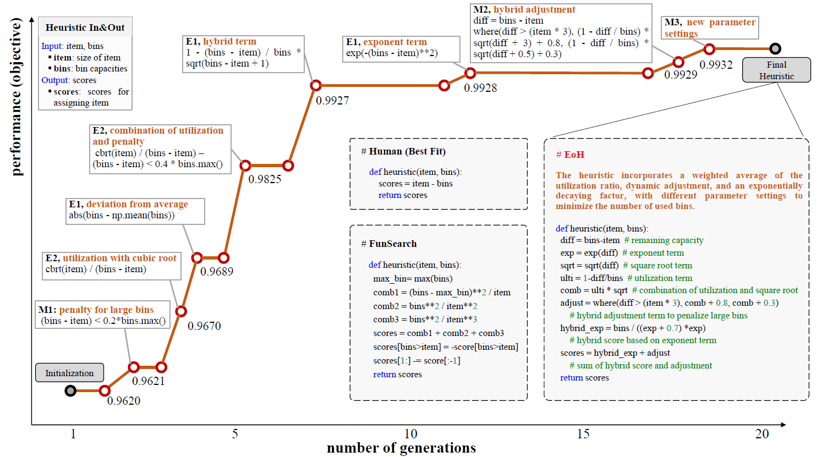
Illustration of Heuristic Evolution on Online BP

Slide 31
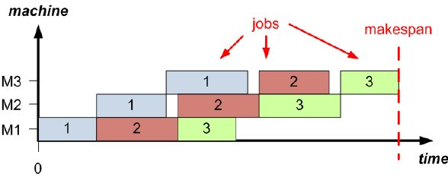
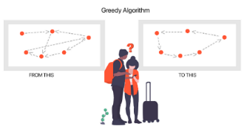
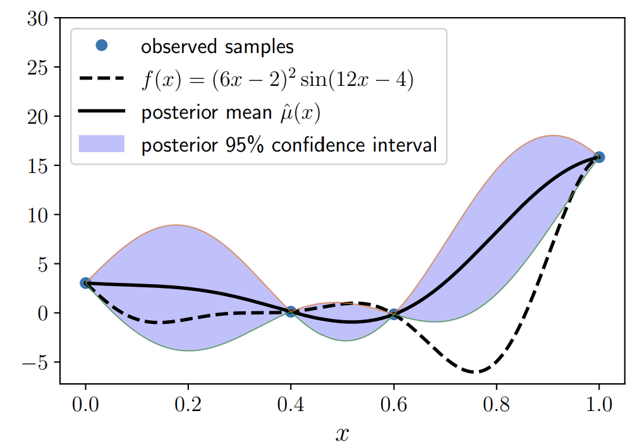
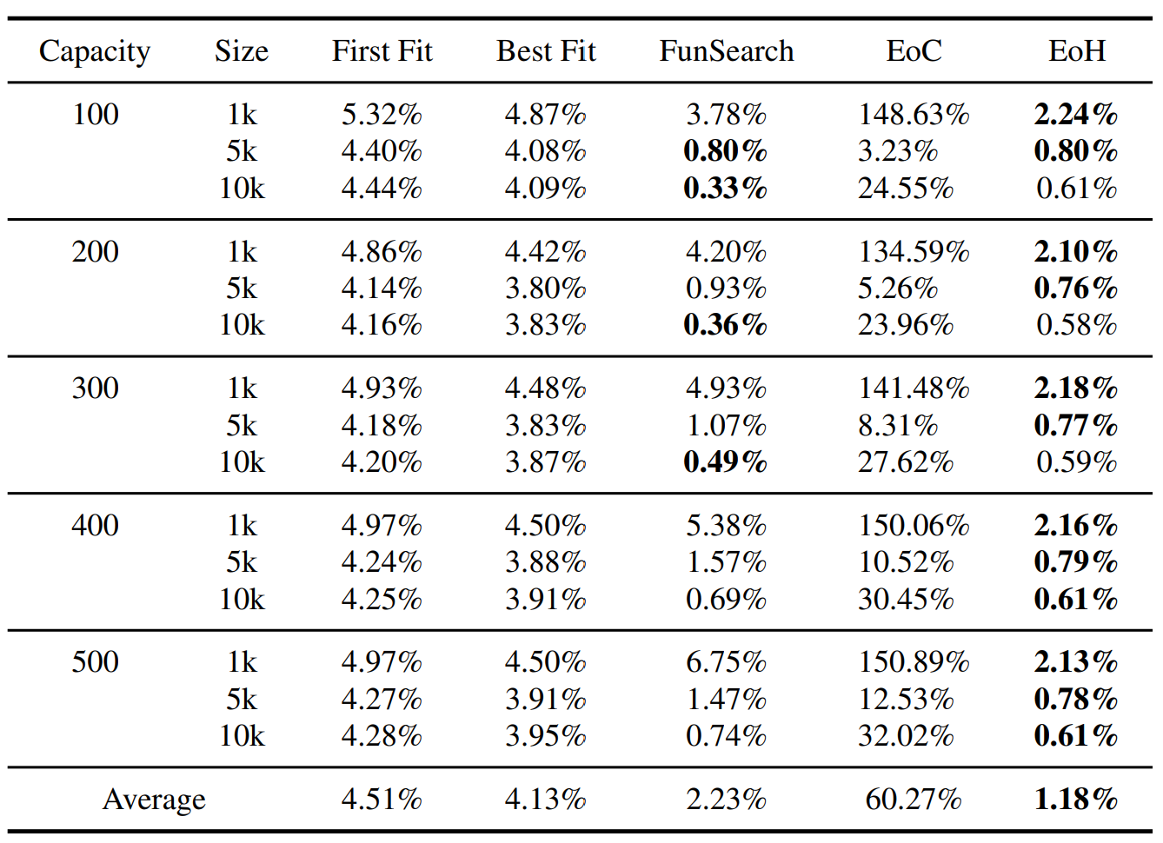
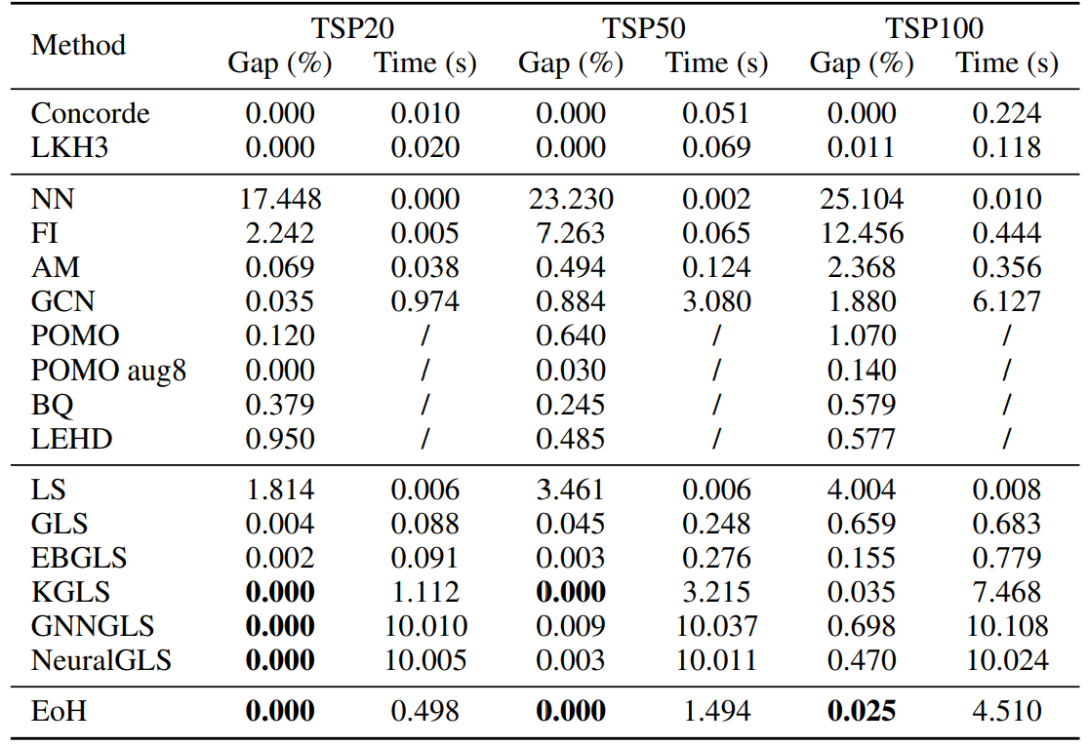
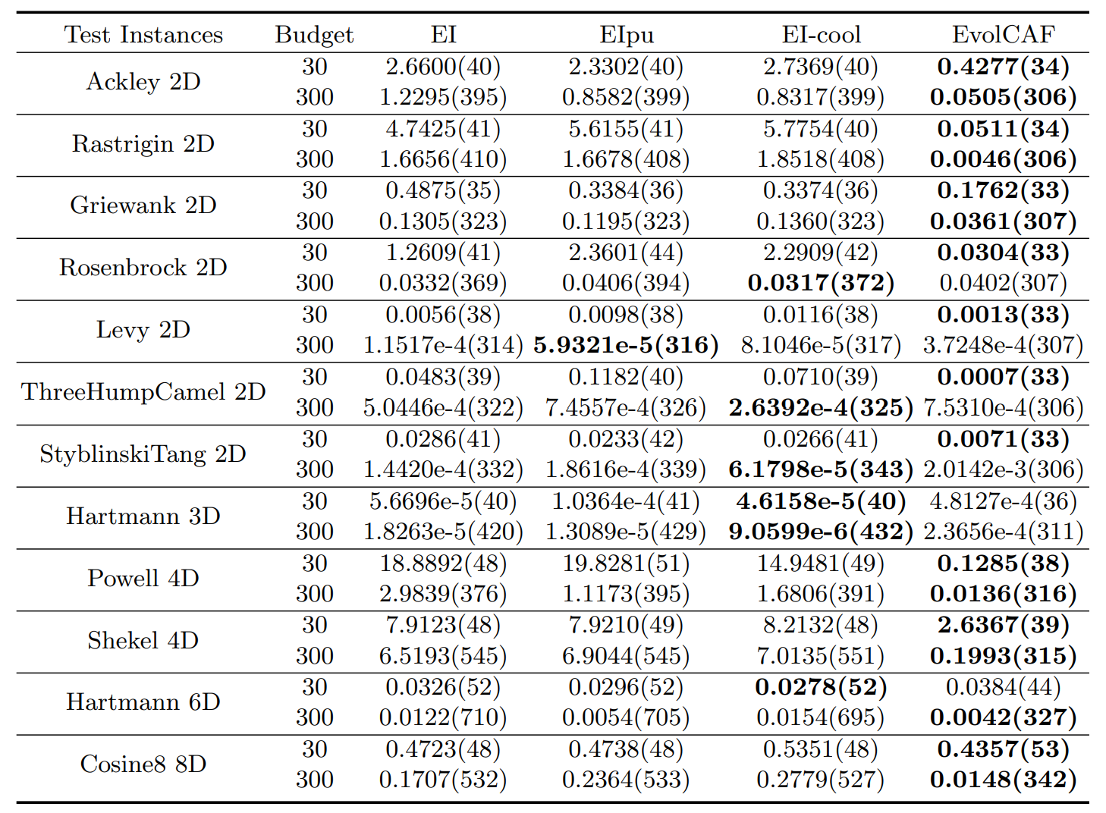
Online Bin Packing
TSP
Bayesian Optimization
EoH beats Human-designed algorithm and google method on OBP
EoH beats 10+ Human-designed and model-based algorithms on TSP
EoH outperforms Human-designed cost-aware Bayesian optimization algorithms

Slide 32
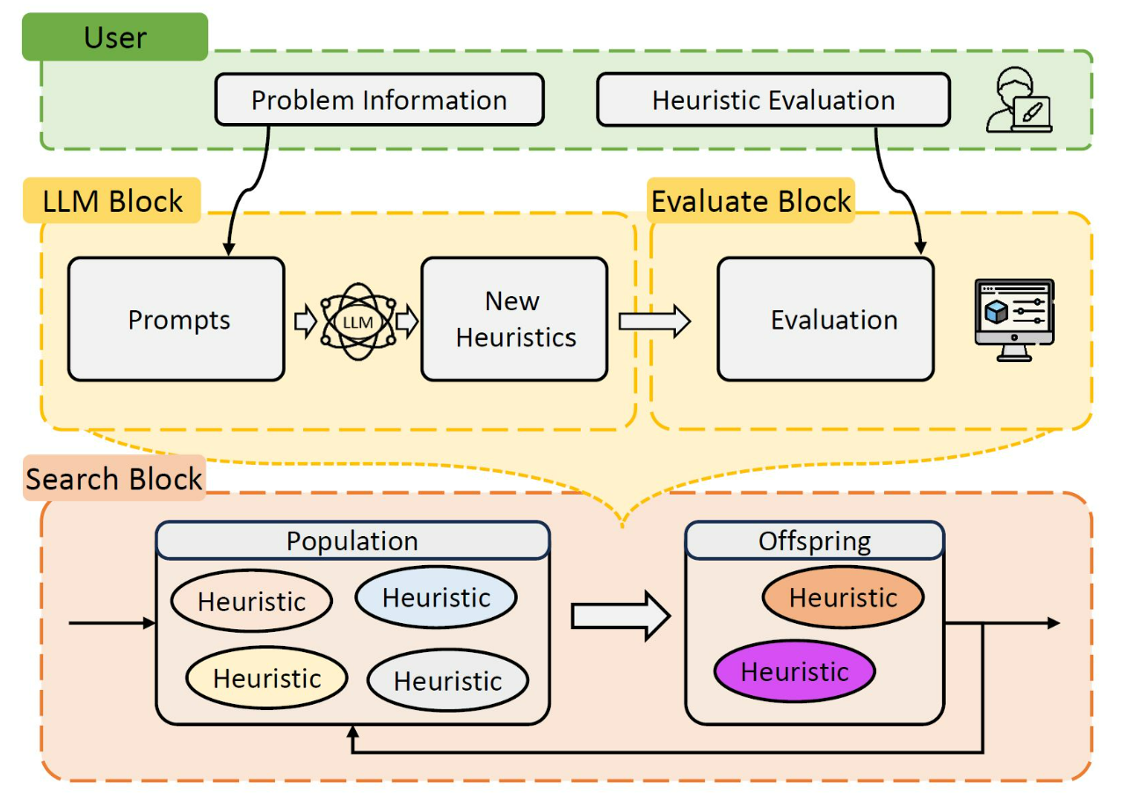
Open-Source EoH Platform
EoH Platform:
https://github.com/FeiLiu36/EoH
Create best-known heuristics in 30 minutes on your personal computer
Propose and test your new heuristic search methods
Apply on your application scenarios

Slide 33
Conclusions
EC+LLM: very promising way for automatic algorithm design.
Long term version: A major tool for alg design. Human-computer interaction. AI generates algorithms and provides math analysis.
Key issues:
how to define, study and understand alg spaces?
how to understand the role of LLM and EC in alg design?
how to understand differences btw alg design and traditional opt?
Fine tuned LLM……

